Slide 1

SRM INSTITUTE OF SCIENCE AND TECHNOLOGY Ramapuram, Chennai – 600 089. DEPARTMENT OF COMPUTER SCIENCE AND ENGINEERING
21CSC205P – DATABASE MANAGEMENT SYSTEM - PROJECT
Smart Ration Distribution and Stock Monitoring System
BATCH NUMBER : 13
Team Members | Supervisor
Harini M – RA2411003020928 Priyanka G – RA2411003020933 Karishma K – RA2411003020951 Supervisor Name & Designation Mrs.S.Chandrakala M.E.,(Ph.D.,) Assistant Professor

Slide 2
Objectives
Develop centralized ration management system
Maintain accurate beneficiary records
Enable real-time stock monitoring
Reduce manual errors and fraud
Ensure transparency and accountability

Slide 3
Tech Stack
Frontend: HTML, CSS
Backend: Java
Database: MySQL
Server: Apache Tomcat
Tools: Eclipse

Slide 4
System Architecture.
User (Admin / Shopkeeper) interacts with system
Frontend (HTML, CSS) handles user interface
Backend (Java) processes requests and logic
Database (MySQL) stores and retrieves data

Slide 5
DataBase Design
Beneficiaries
Stores user details
Fields: beneficiary_id (PK), name, ration_card_no, category
Ration Cards
Maintains card information
Fields: card_id (PK), beneficiary_id (FK), card_type
Shops
Stores ration shop details
Fields: shop_id (PK), shop_name, location
Stock
Maintains commodity availability
Fields: stock_id (PK), shop_id (FK), item_name, quantity_available
Transactions
Records distribution details
Fields: transaction_id (PK), beneficiary_id (FK), shop_id (FK), item_name, quantity, dat

Slide 6
Backend Modules.
Authentication Module (Login & Security)
Beneficiary Management
Stock Management
Transaction Handling
Report Generation

Slide 7
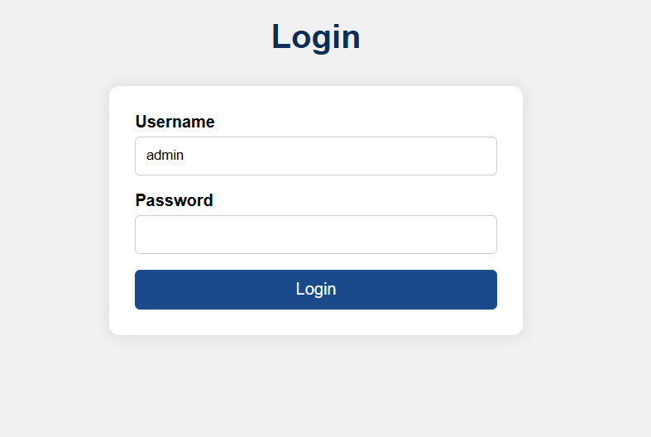
Frontend
Login page

Slide 8
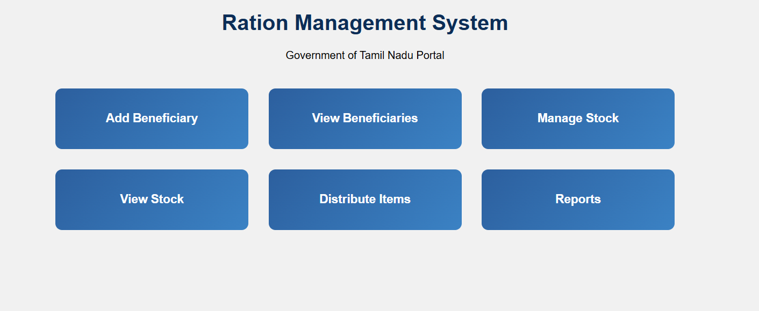
Dashboard

Slide 9
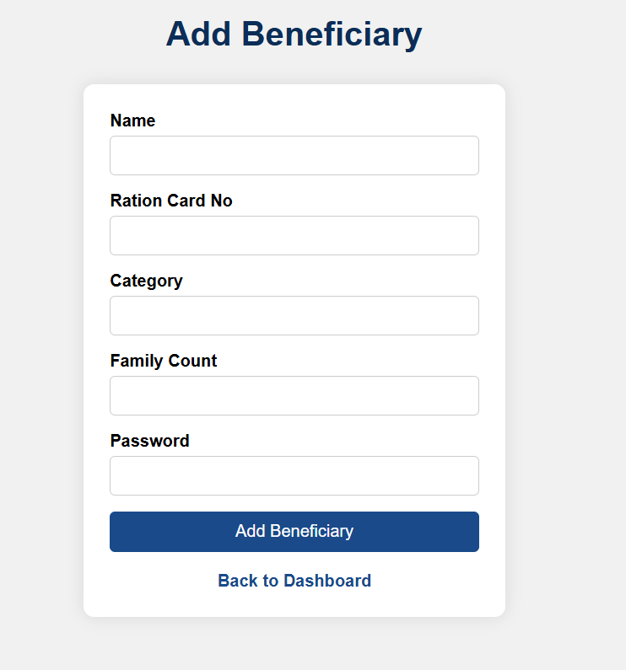

Slide 10
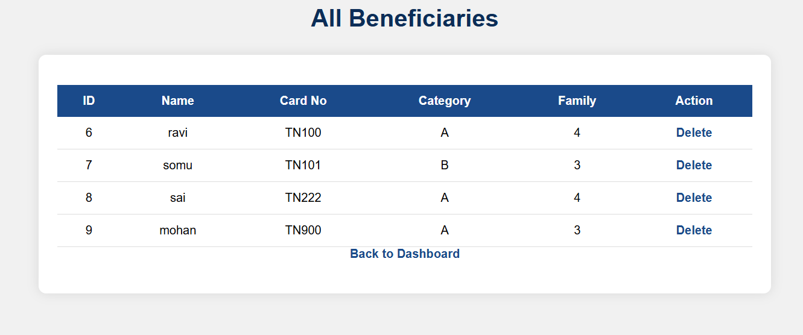

Slide 11
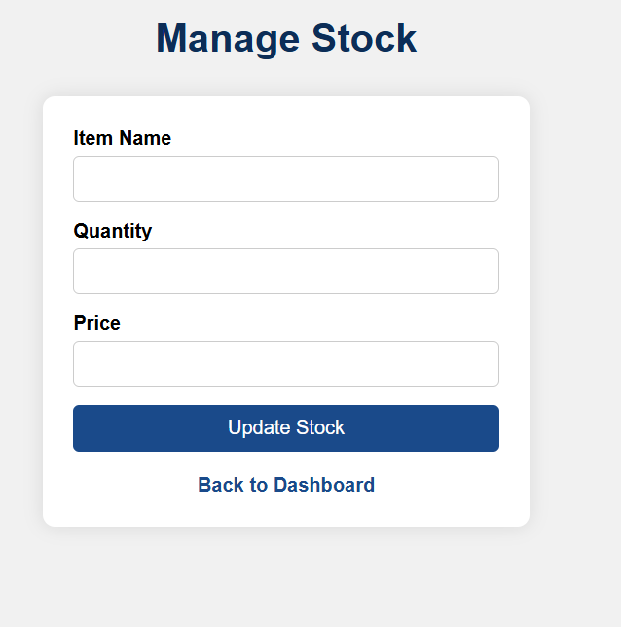

Slide 12
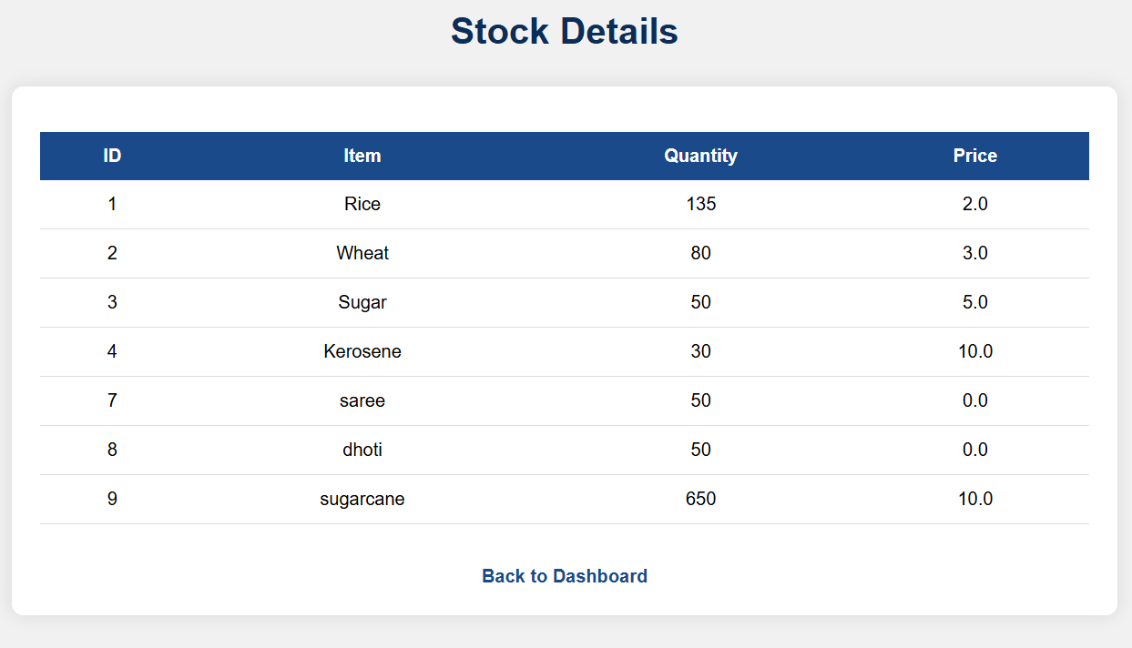

Slide 13
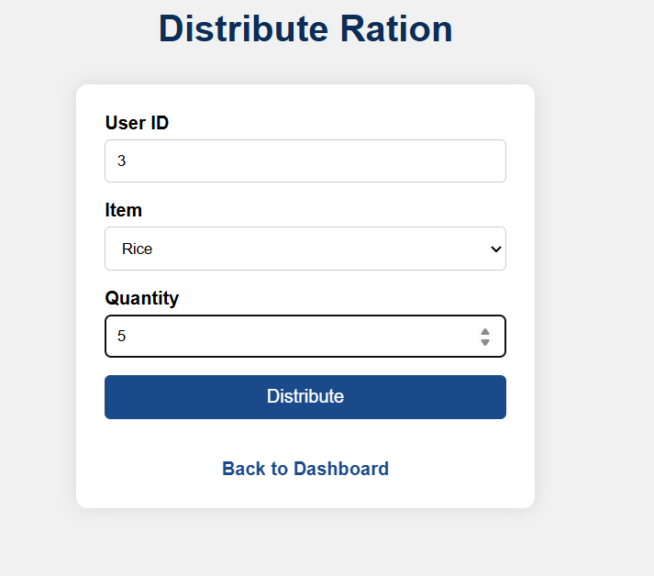

Slide 14
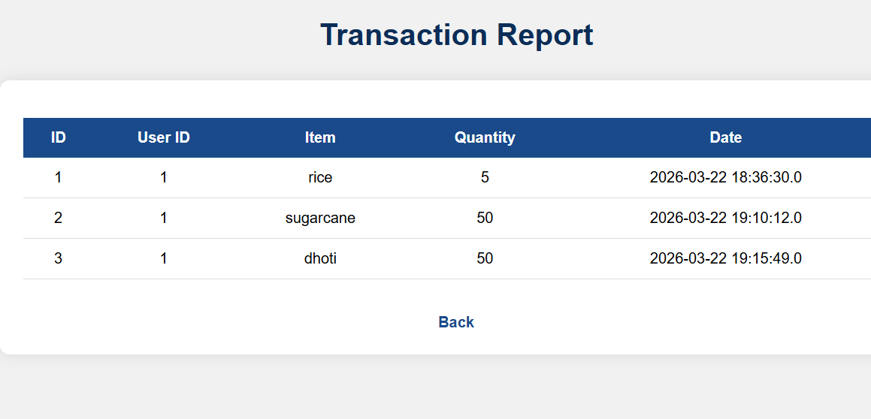

Slide 15
Team Work Distribution
Harini M – Database Design
Priyanka G – Frontend Development
Karishma K – Backend & Testing

Slide 16
Timeline (8 Weeks Plan)
Week 1–2: Requirement Analysis
Week 3–4: Design
Week 5–6: Development
Week 7: Testing
Week 8: Documentation

Slide 17
Conclusion
Problem identified
Solution proposed
Tools finalized
Ready to start development
Thank You

